Slide 1



r/place 2023 Analysis
Ashkan Taghavi, Jake Aaknes, Nick Seah

Slide 2





DEALING WITH THE DATA
53 r/Place csv Files
Due to the size of the data, our initial attempts to download and store the data failed
Shifted Project to Utilize Cloud Resources
Storage with Amazon S3 Buckets
AWS Glue to handle joining csv’s to create one large file containing all observations
Amazon SageMaker for Analysis and Jupyter Notebook Cloud interface

Slide 3
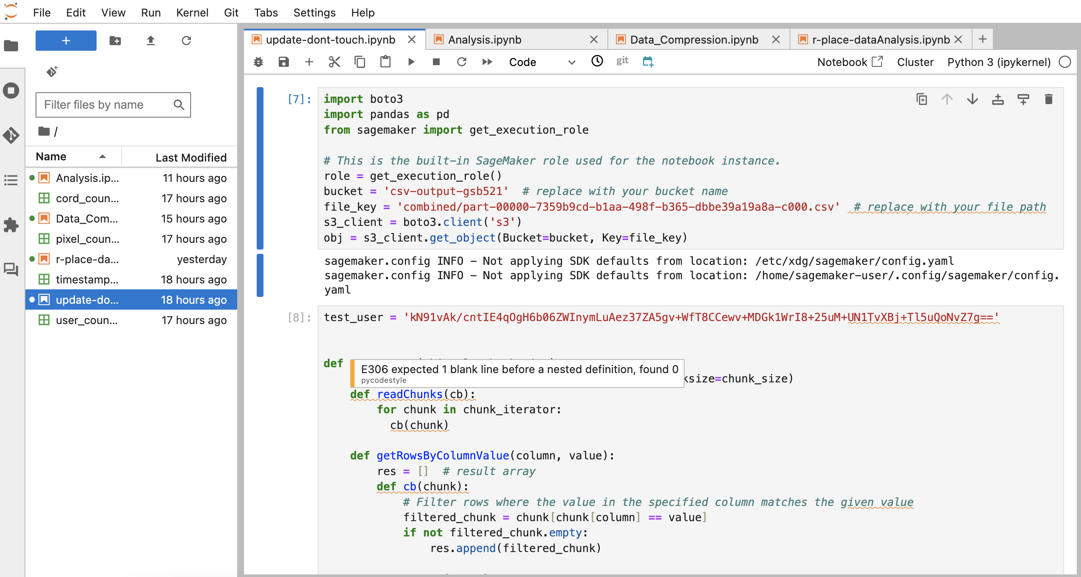
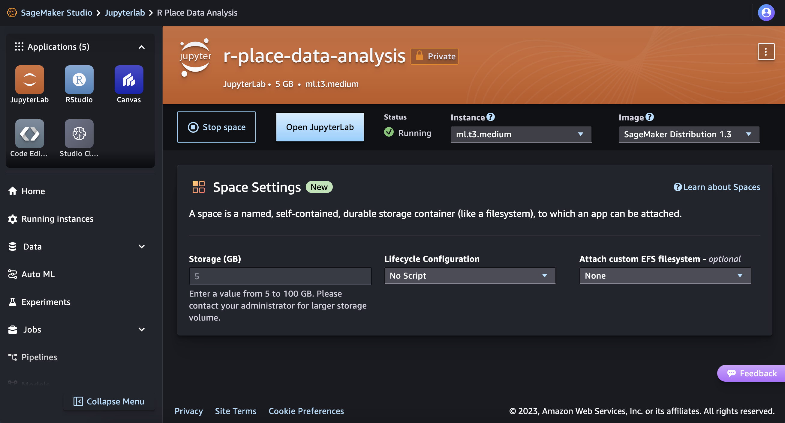
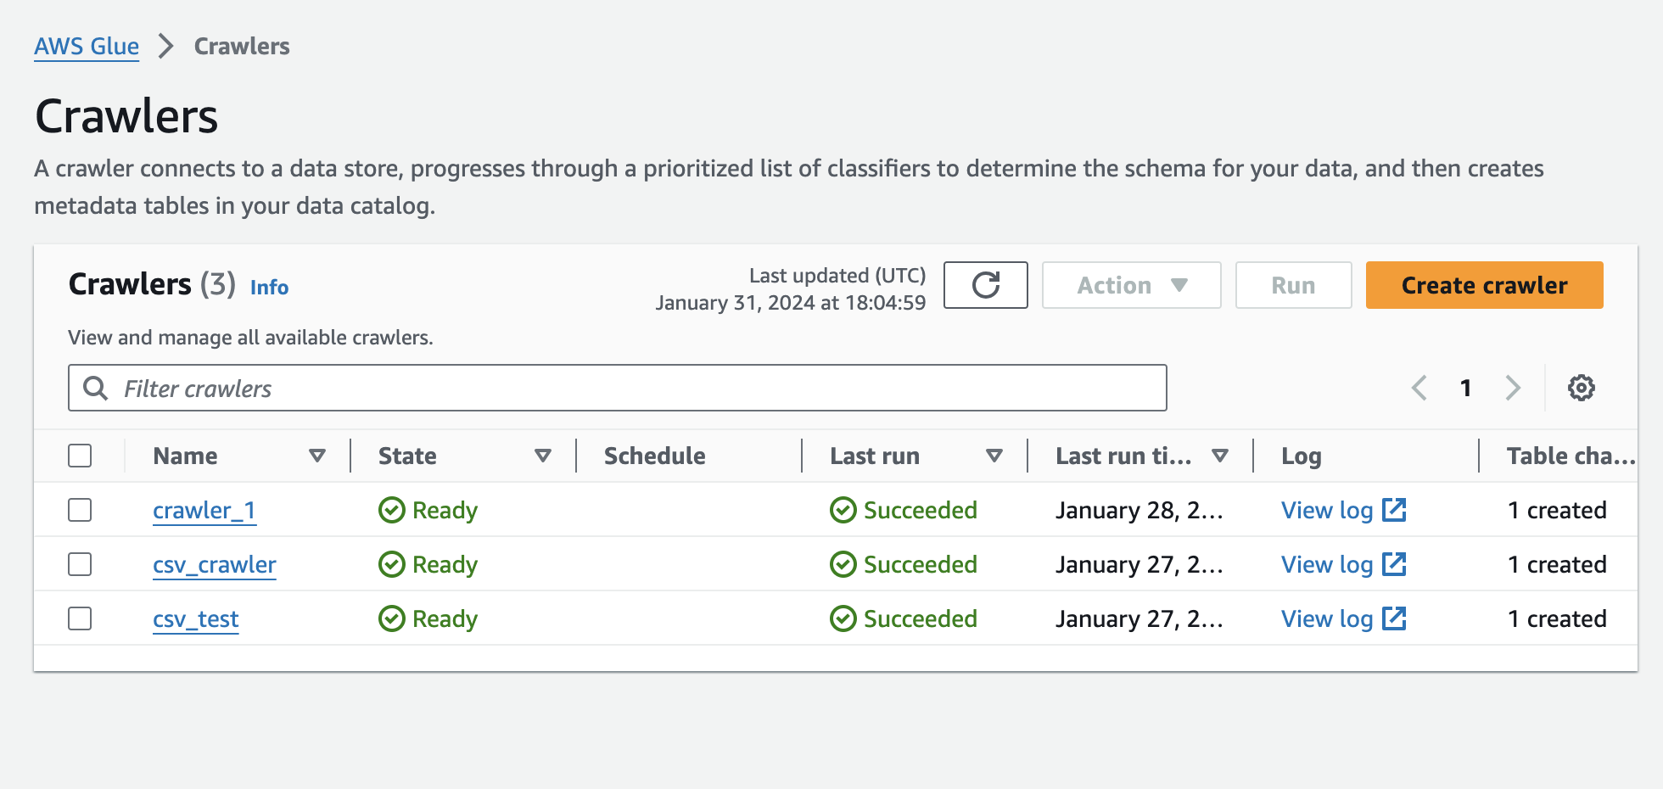
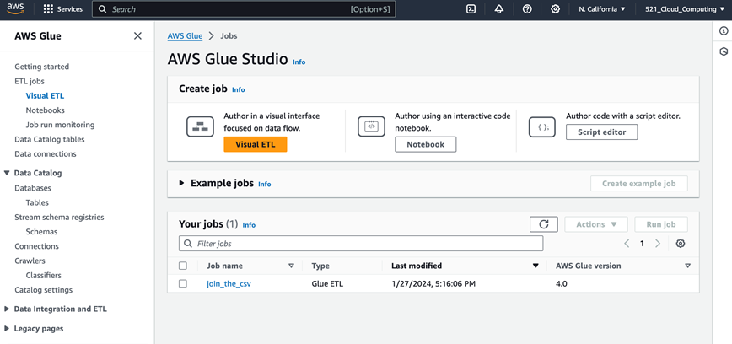
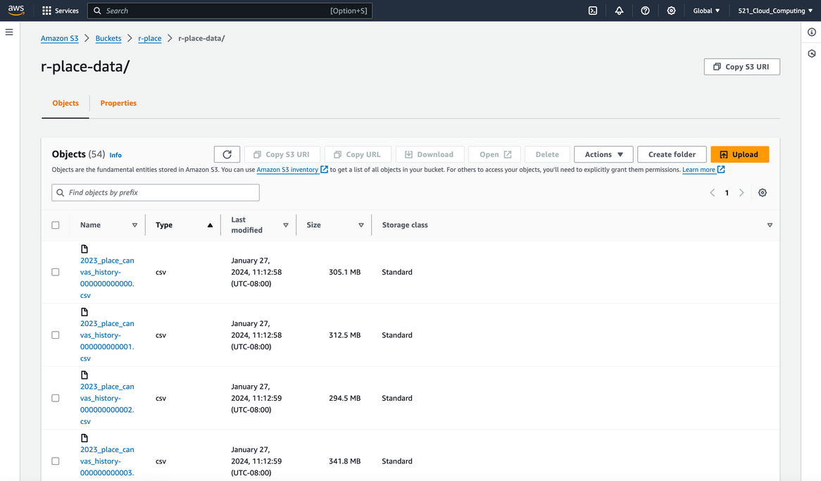
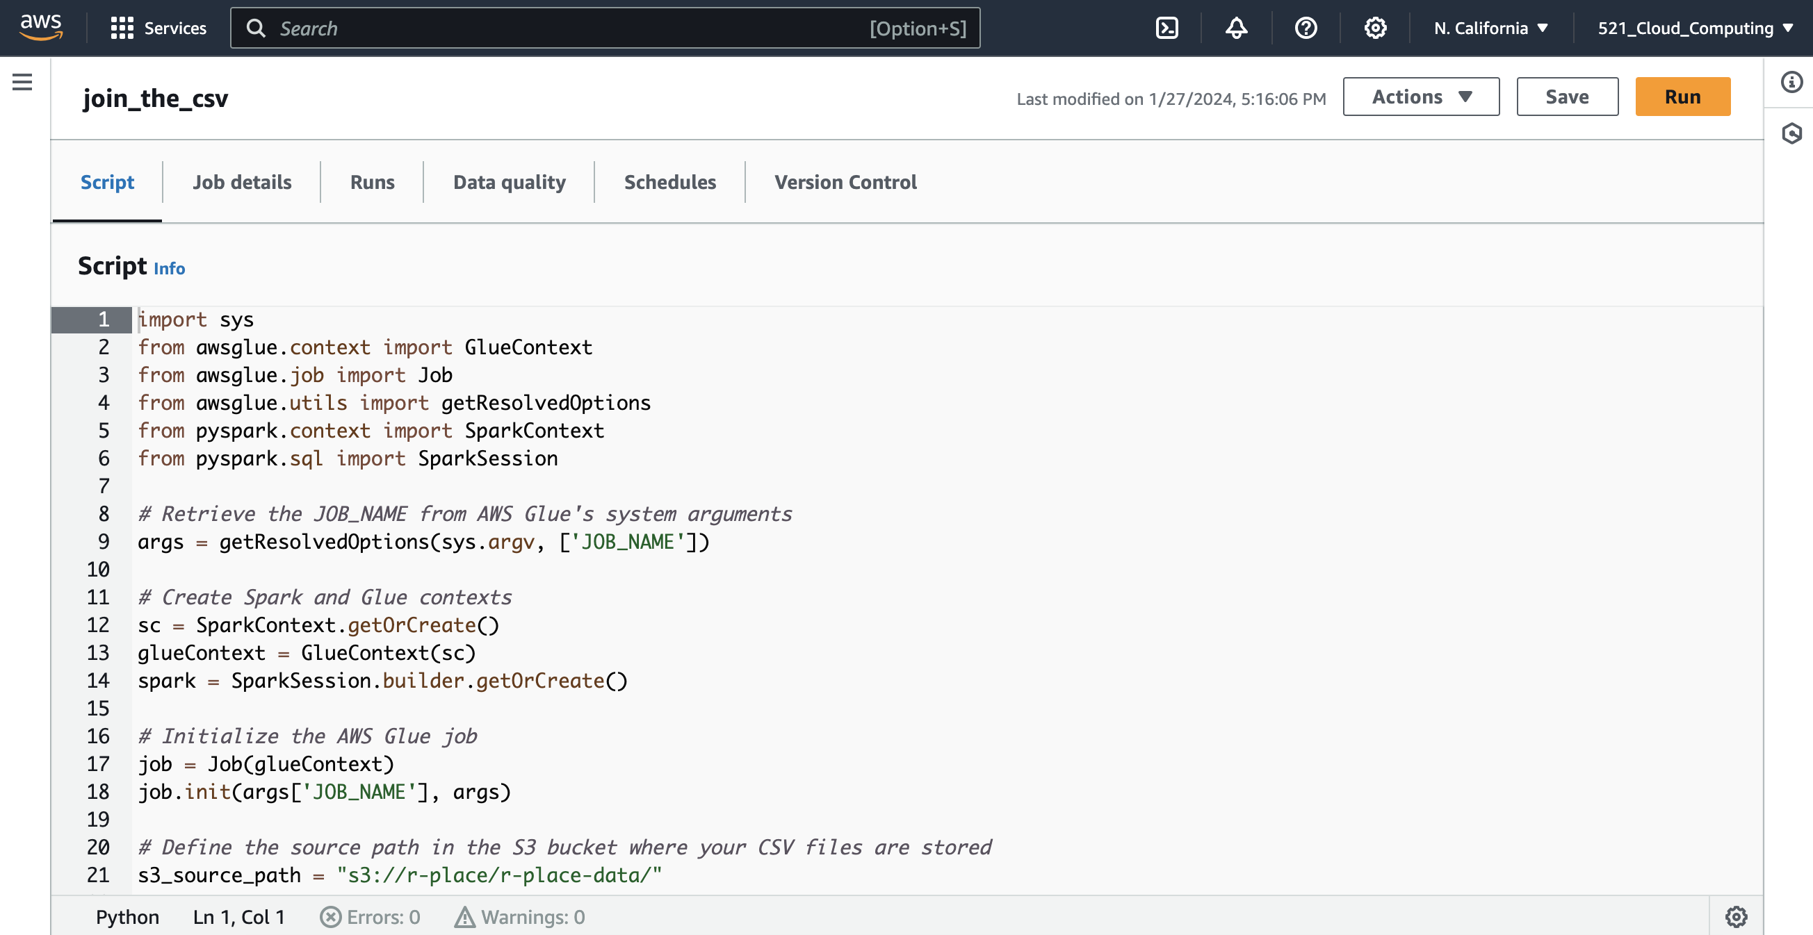
CLOUD DATA PROCESSING
Step 1: S3 Bucket for storage and cloud access
Step 2: AWS Glue for concatenating the 53 CSV files
Step 3: Amazon SageMaker for analysis and Jupyter Notebook scripting

Slide 4
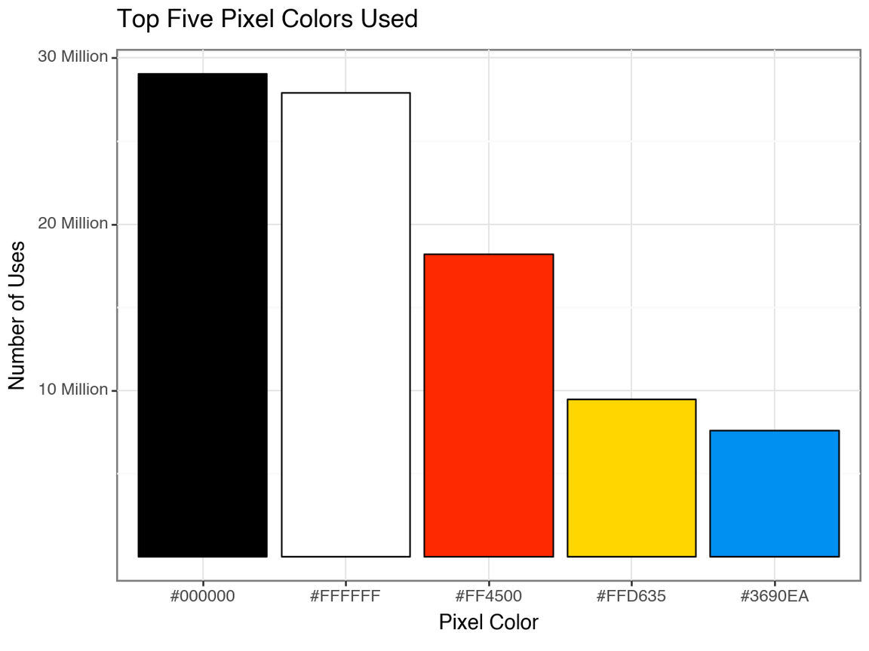
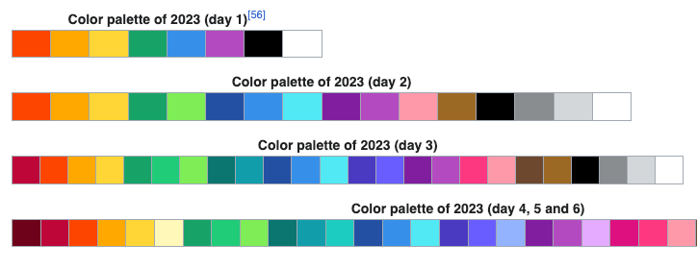
When r/place launched in 2023, only 8 colors were available

Slide 5
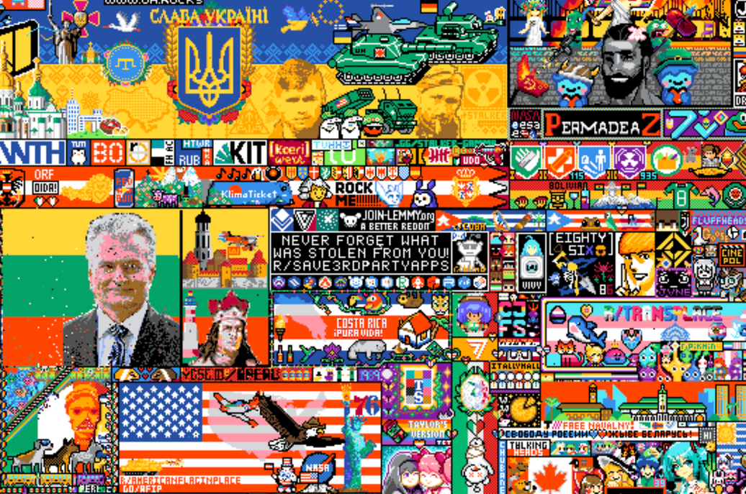
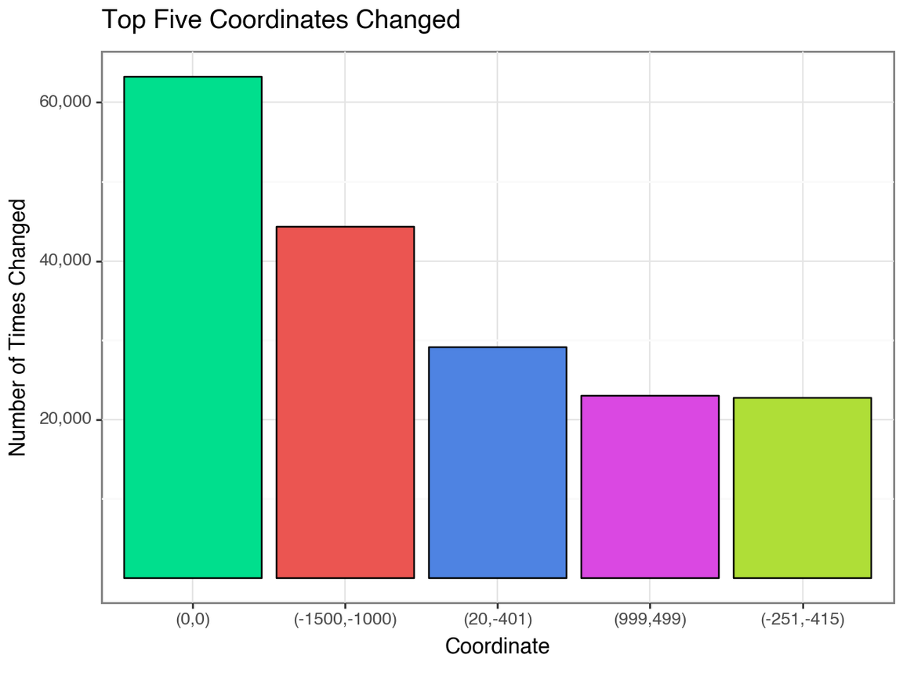
r/Save3rdPartyApps is a subreddit protesting the pricing changes to Reddit's API

Slide 6
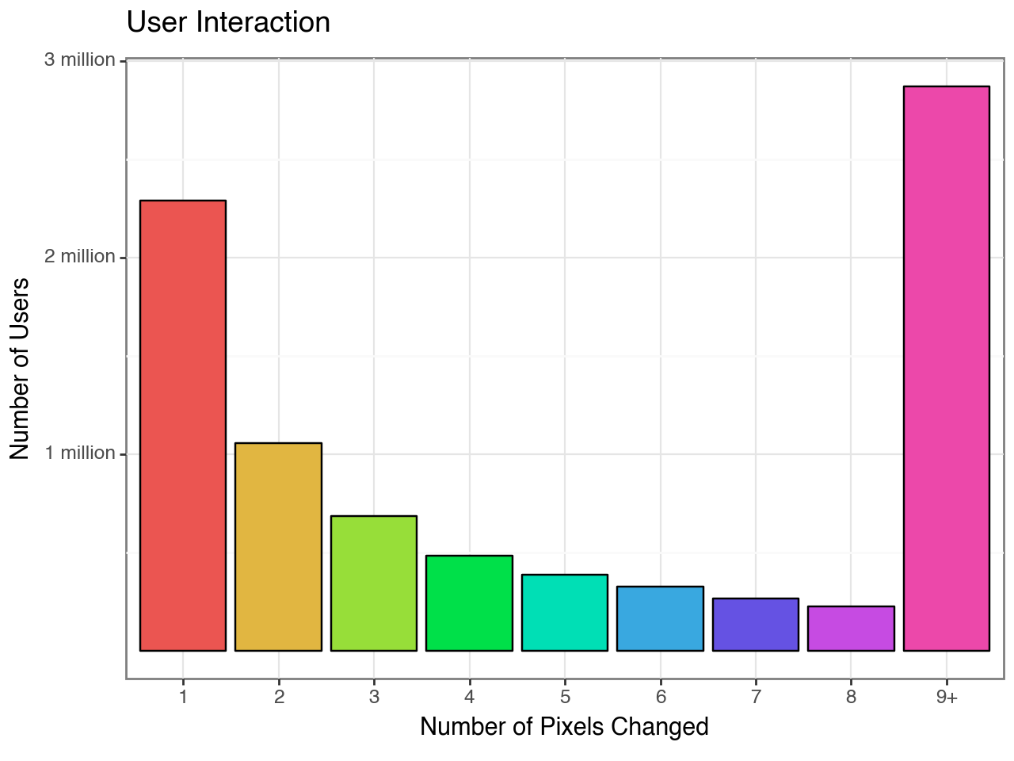
Total of 8,589,732 users interacted with r/place 2023
2,288,363 users only changed one pixel
Who interacted with r/place the most?

Slide 7
Addressing Bots
Initial Thoughts:
Easily reproducible images such as country flags
Research Findings:
Cool Down Period - An average of a 5 minute cool down before placing a pixel
Given r/place was available for 120 hours (5 days), this would equate to 1440 total pixel changes
Top three users occupied pixels mainly on flags like Switzerland and France
Next Steps:
Assume the top 5 users are bots, what areas of the image are they targeting?

Slide 8
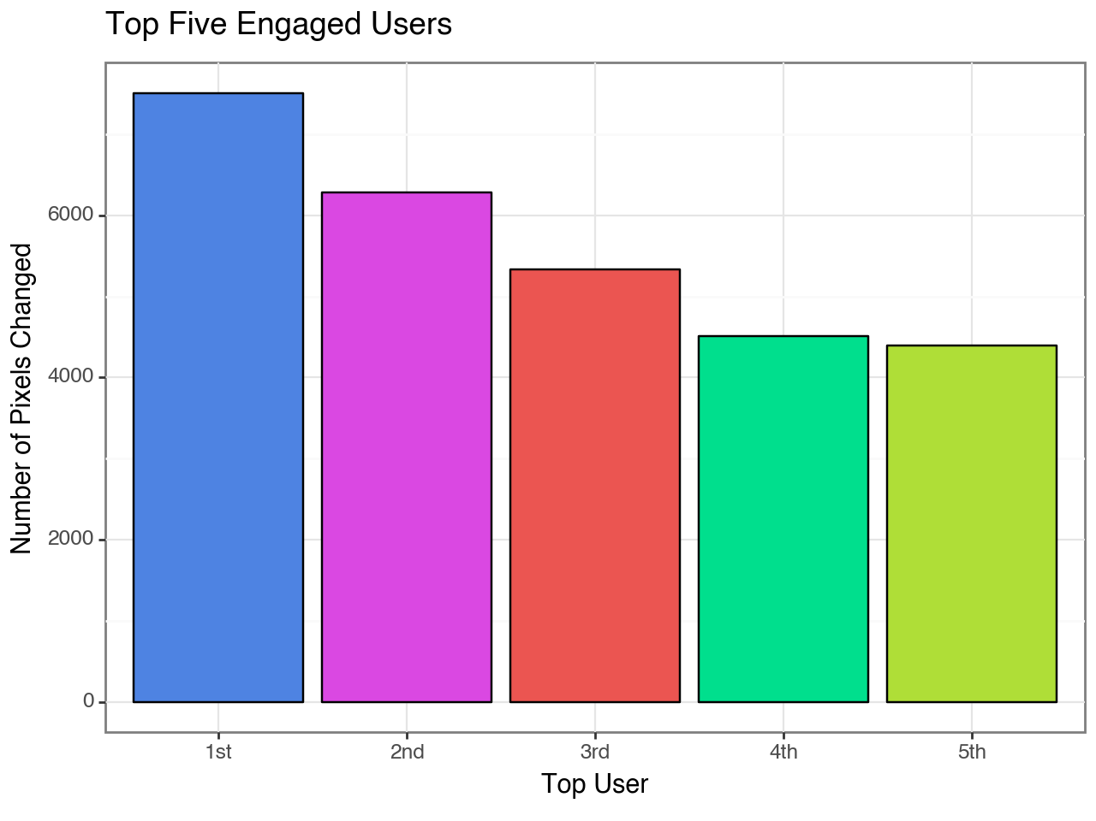
The 1st top user changed 7,504 pixels
The 5th top user changed 4,390 pixels
Bots vs Admin?
Where were most of their pixels located?

Slide 9
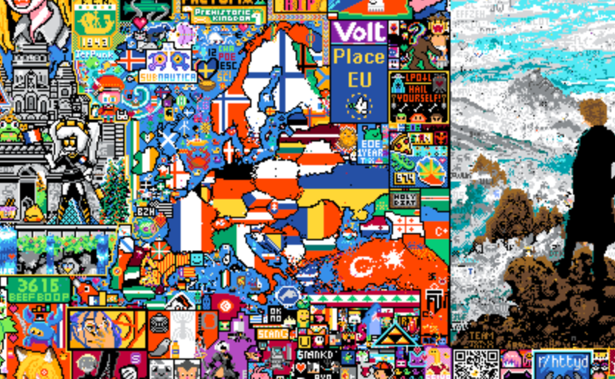
Of the top 5 users, most pixels were changed in the European region

Slide 10
THANK YOU
Have any questions?

